Slide 1
volcanic power generation
video : Shinya Nakamura
Article : Kamizono Yoshinori

Slide 2
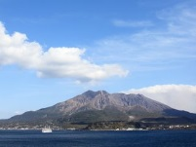

Slide 3
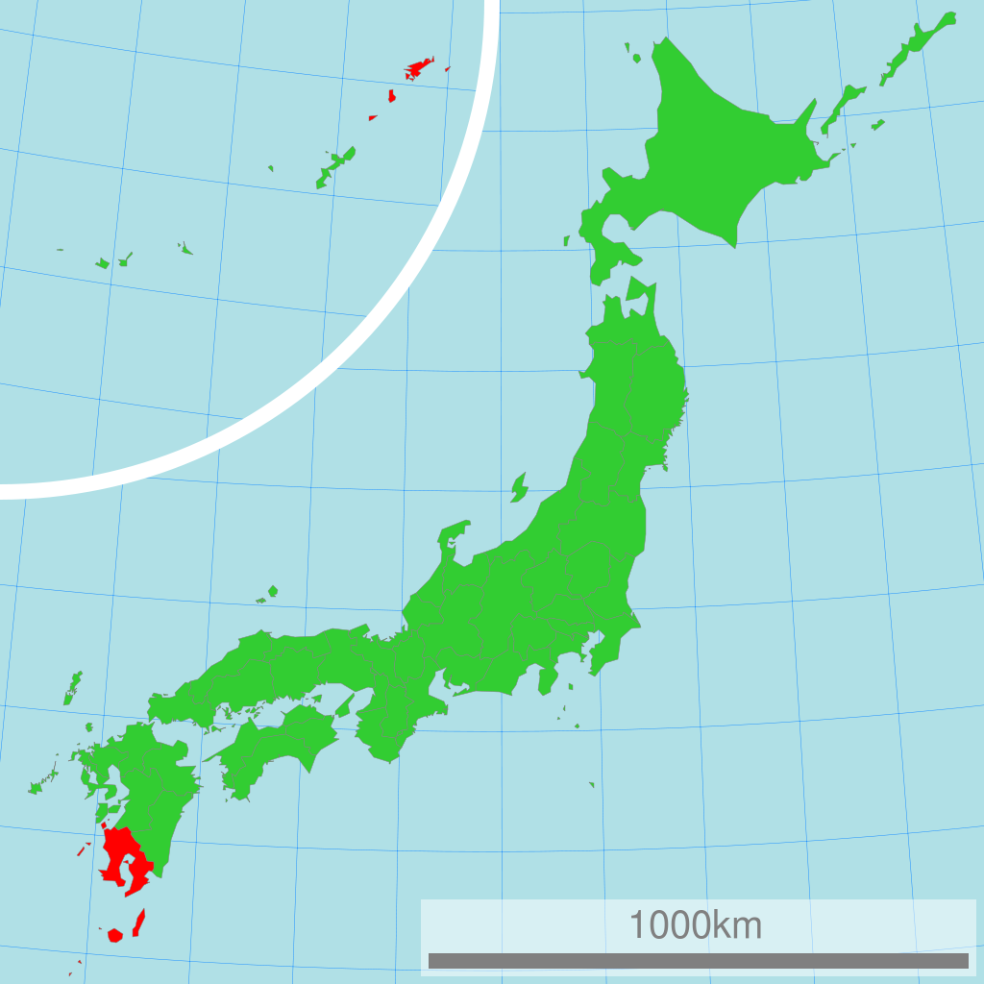

Slide 4
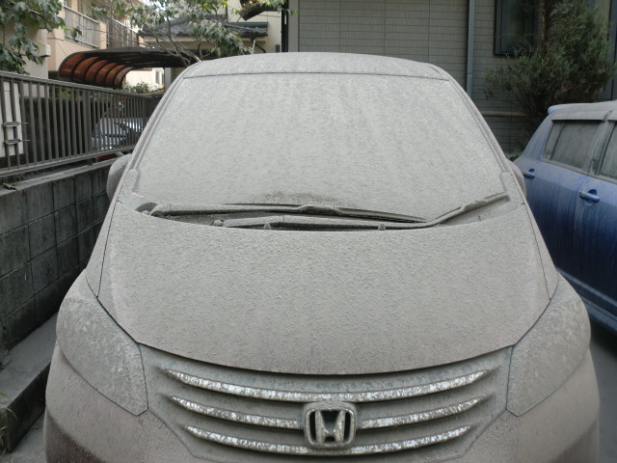

Slide 5
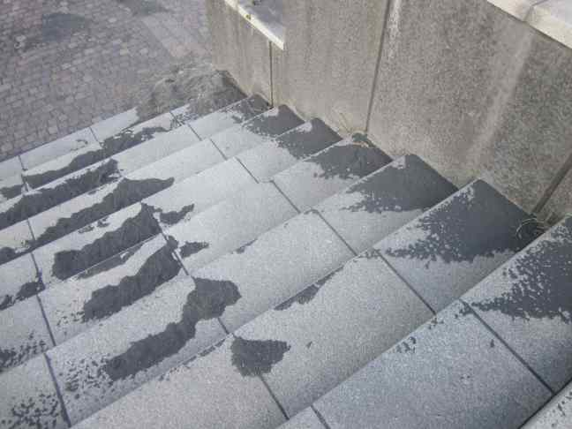

Slide 6


Slide 7
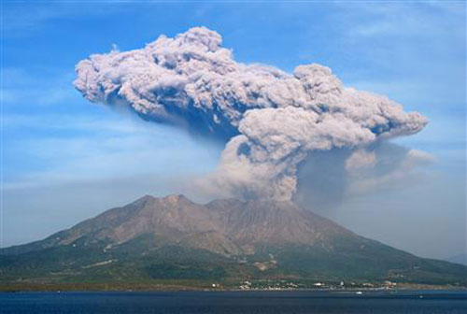

Slide 8
1355 times (2011) 1126 times(~June 2015)

Slide 9
A new type of power generation
Enourmous energy
Enviromently friendly

Slide 10
Volcanic power generation

Slide 11
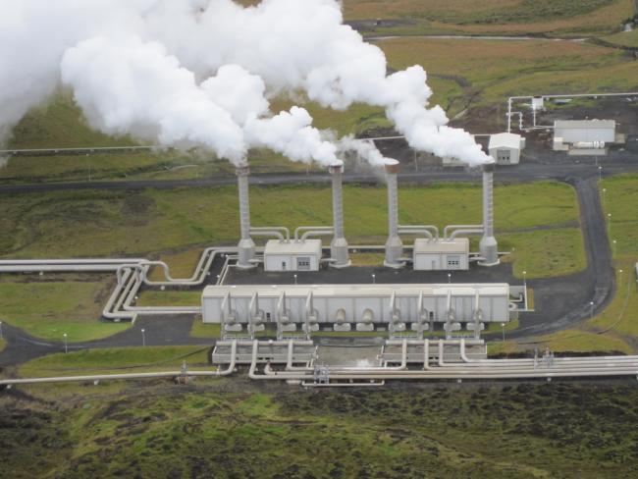

Slide 12
Advantages similar to geothermal power generation
Eco – friendly
Renewable
High stability
etc…

Slide 13
Volcanic power generation can produce much more energy!

Slide 15
1.Difficult to stabilize
2.Most volcanoes are
protected in national parks
or natural parks

Slide 16
Enourmous & Valuable power

Slide 17
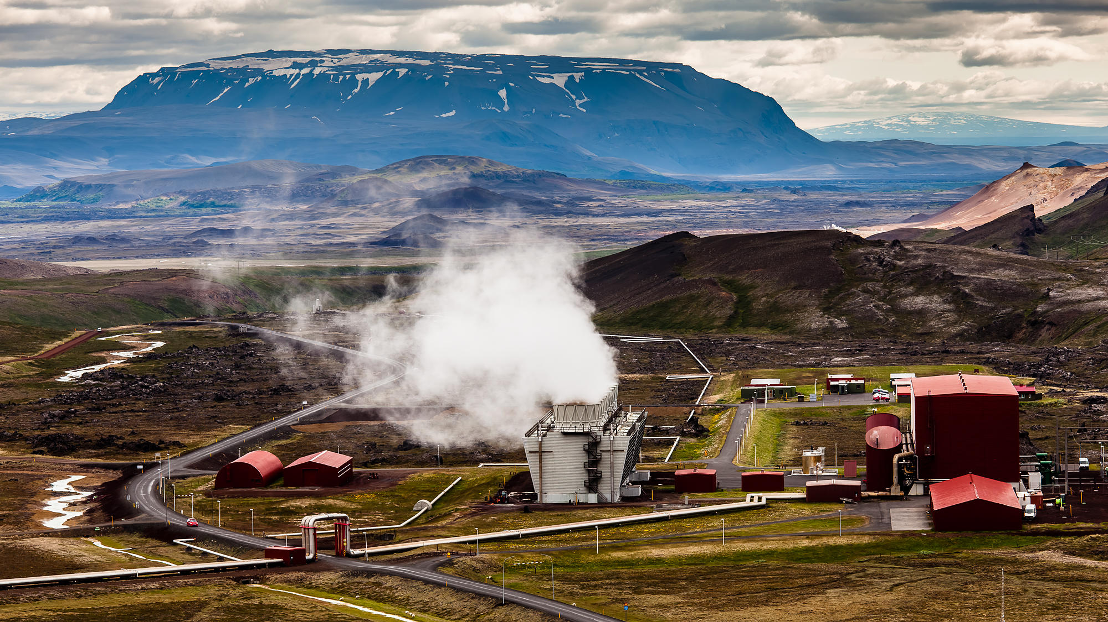

Slide 18
Data Sourse
データ:http://蓄電池.net/kinds/geo.html
http://www.jma-net.go.jp/kagoshima/vol/data/skr_erp_num.html
http://karapaia.livedoor.biz/archives/52193183.html
http://gigazine.net/news/20140130-volcano-power-electricity/
https://www.docojapan.com/power/geothermal/

